Slide 1
CS2005 Database Systems
Fall 2022
National University of Computer and Emerging Sciences

Slide 2
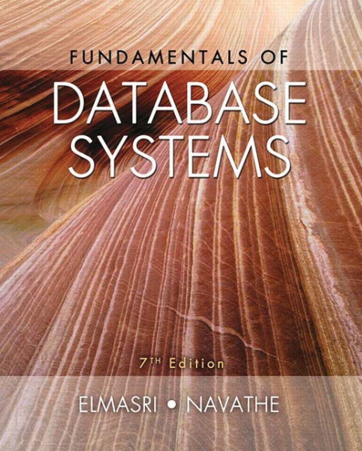
Instructor
Muhammad Danish Khan
Lecturer, Department of Computer Science
FAST NUCES Karachi
m.danish@nu.edu.pk
Recommended Text Book
FUNDAMENTALS OF Database Systems
SEVENTH EDITION
Ramez Elmasri, Shamkant B. Navathe

Slide 3
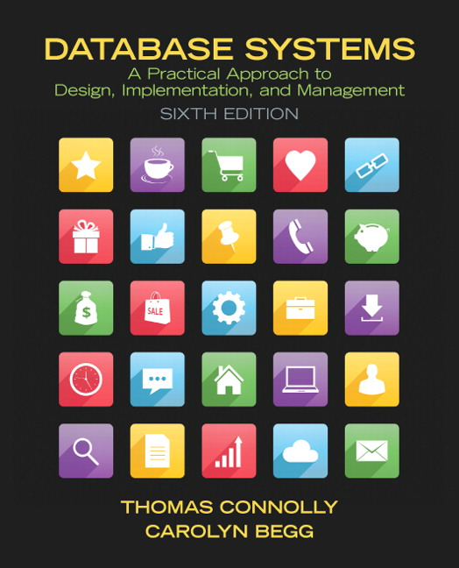
Reference Book
DATABASE SYSTEMS
Sixth Edition
Thomas Connolly, Carolyn Begg

Slide 4
Marks Distribution and Deadlines
Assessment | Weightage | Schedule/Deadlines/ Remarks
Mid-term I Examinations | 15 | 6th Week
Mid-term II Examinations | 15 | 12th Week
Quizzes/Assignments/Tasks | 10 | 3 Quizzes + 3 Assignments/Tasks
Semester Project | 10 | Project Idea submission: 7th week, Final Submission due in 15th - 16th Week
Final Examinations | 50 | Comprehensively from all the covered and assigned topics.

Slide 5
Pre-Requisite
CS-2001 (Data Structures)

Slide 6
Semester Plan
Week 1 – Week 2: Chapter 1, Chapter 2, Chapter 5
Week 2 – Week 4: Chapter 5, Chapter 6
Week 5: Chapter 7, Assignment 1 , Quiz1
Week 6: MIDTERM I Examination
Week 7 – Week 8: Chapter 3, Chapter 8, Project Proposals Submissions
Week 8 – Week 9: Chapter 8,
Week 9 – Week 11: Chapter 14, Assignment 2, Quiz2
Week 12: MIDTERM II Examination

Slide 7
Semester Plan
Week 13 – Week 14: Chapter 20, Chapter 21
Week 15 – Week 16: Chapter 22, Chapter 24, Assignment 3, Quiz 3, Projects Evaluations

Slide 8
LMS: Google Class Room
BCY-5A Class Code: e74ls2u
https://classroom.google.com/c/NTQ0NTI0ODU1MzY0?cjc=e74ls2u

Slide 9
DATABASE ???

Slide 10
A database is a collection of related data.
For example, consider the names, telephone numbers, and addresses of the people you know. Nowadays, this data is typically stored in mobile phones, which have their own simple database software
A database represents some aspect of the real world, sometimes called the miniworld or the universe of discourse (UoD)

Slide 11
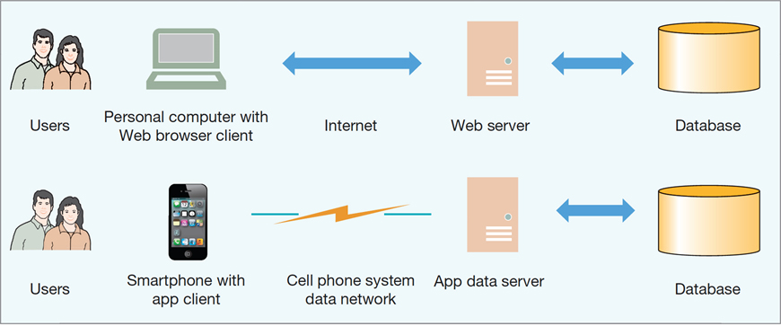
Users Are Dependent on Databases
The Internet and Mobile Device World

Slide 12
Purpose of a Database
The purpose of a database is to keep track of things.
Unlike a list or spreadsheet, a database may store information that is more complicated than a simple list.

Slide 13
Relational Database
A relational database stores data in tables called Relations.
Each table holds data about one single theme.
Relational databases minimize data redundancy, preserve complex relationships, and allow for partial data.

Slide 14
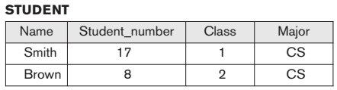
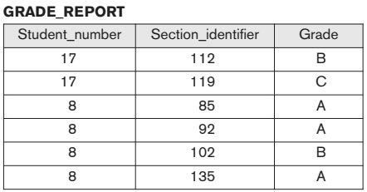
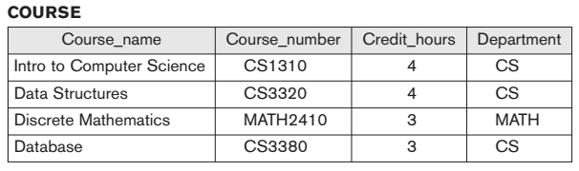
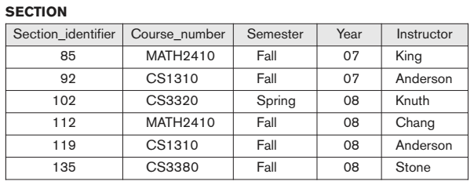

Slide 15
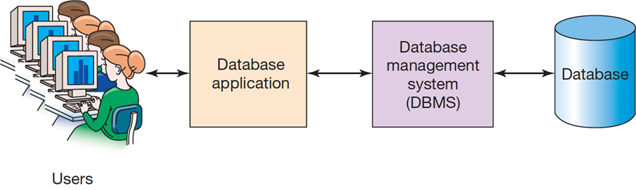
What is a Database System?
A database system is comprised of four components:
Database
Database Management System (D B M S)
Database Application
Users

Slide 16
Database Management System (DBMS)
A database management system (DBMS) is a computerized system that enables users to create and maintain a database.
The D B M S manages and controls database activities.

Slide 17
Typical DBMS Functionality
Define a particular database in terms of its data types, structures, and constraints
Construct or Load the initial database contents on a secondary storage medium
Manipulating the database:
Retrieval: Querying, generating reports
Modification: Insertions, deletions and updates to its content
Accessing the database through Web applications
Processing and Sharing by a set of concurrent users and application programs – yet, keeping all data valid and consistent

Slide 18
Additional DBMS Functionality
DBMS may additionally provide:
Protection or Security measures to prevent unauthorized access
“Active” processing to take internal actions on data
Presentation and Visualization of data
Maintenance of the database and associated programs over the lifetime of the database application
Called database, software, and system maintenance

Slide 19
Defining a database involves specifying the data types, structures, and constraints of the data to be stored in the database.
The database definition or descriptive information is also stored by the DBMS in the form of a database dictionary called meta-data
A database is a self-describing collection of related tables

Slide 20
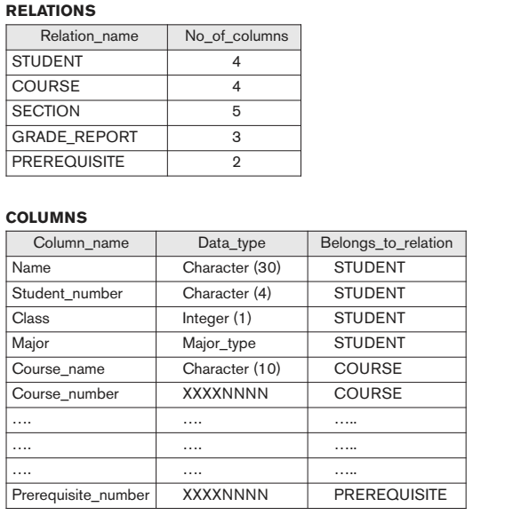
e.g. Database Catalog: Metadata

Slide 21
Application Activities Against a Database
Applications interact with a database by generating Queries: that access different parts of data and formulate the result of a request
Transactions: that may read some data and “update” certain values or generate new data and store that in the database
Applications must not allow unauthorized users to access data
Applications must keep up with changing user requirements against the database

Slide 22
Relational Tables are Processed by Structured Query Language (S Q L)
Structured Query Language (SQL) is an international standard for creating, processing, and querying databases and their tables.
Many databases use S Q L to retrieve, format, report, insert, delete, and/or modify data for users.

Slide 23
S Q L Example (1 of 2)
We can use S Q L to combine the data in the three tables in the Art Course Database to recreate the original list structure of the data that was in the spreadsheet.
We do this by using an S Q L SELECT statement as shown on the next slide.

Slide 24

S Q L Example (2 of 2)
The results of this S Q L code can be seen on the next page.

Slide 25
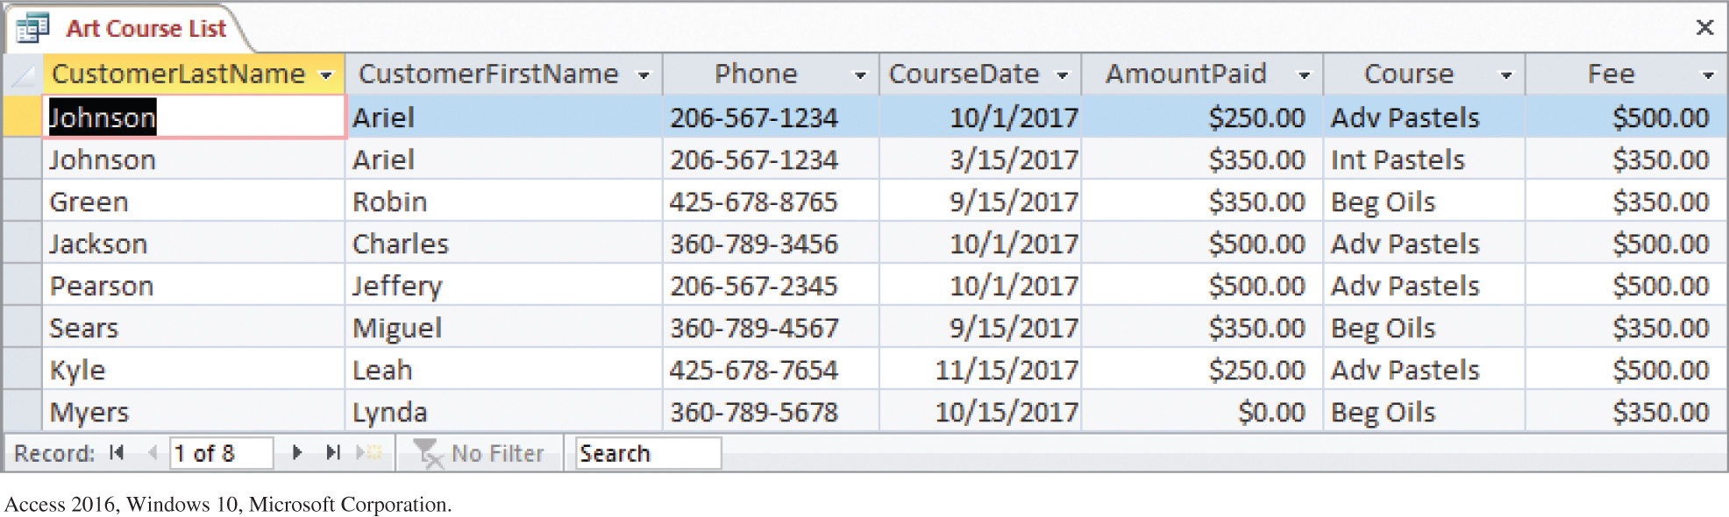
S Q L Example Results for the Art Course Database
Results of the S Q L Query to Recreate the Art Course List Data

Slide 26
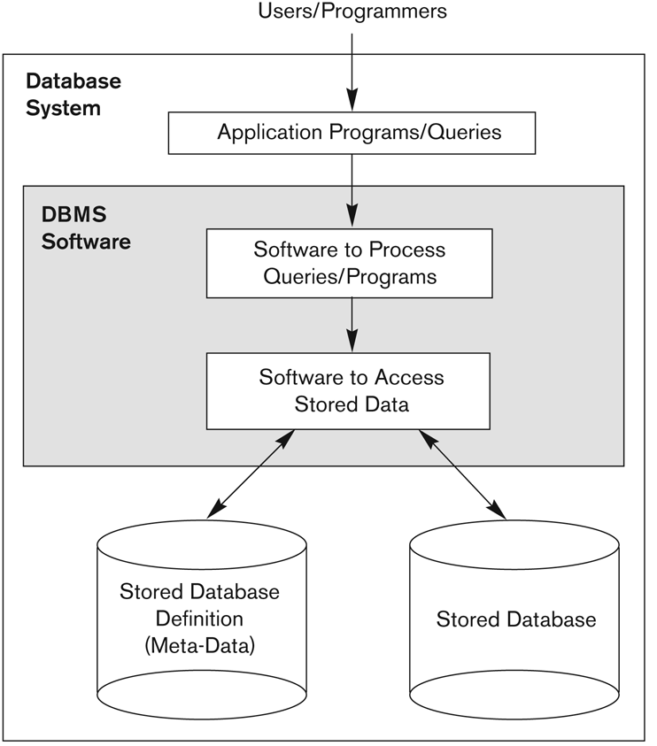
Simplified database system environment

Slide 27
Users
A user of a database system will:
Use a database application to track things
Use forms to enter, read, delete, and query data
Produce reports

Slide 28
Database Users
Users may be divided into
Those who actually use and control the database content, and those who design, develop and maintain database applications (called “Actors on the Scene”), and
Those who design and develop the DBMS software and related tools, and the computer systems operators (called “Workers Behind the Scene”).

Slide 29
Database Users – Actors on the Scene
Database administrators:
Responsible for authorizing access to the database, for coordinating and monitoring its use, acquiring software and hardware resources, controlling its use and monitoring efficiency of operations.
Database Designers:
Responsible to define the content, the structure, the constraints, and functions or transactions against the database. They must communicate with the end-users and understand their needs.

Slide 30
Database Users – Actors on the Scene
End-users: They use the data for queries, reports and some of them update the database content. End-users can be categorized into:
Casual: access database occasionally when needed
Naïve or Parametric: Any user who does not have any knowledge about database can be in this category, they make up a large section of the end-user population.
They use previously well-defined functions in the form of “canned transactions” against the database.
Users of Mobile Apps mostly fall in this category
Bank-tellers or reservation clerks are parametric users who do this activity for an entire shift of operations.
Social Media Users post and read information from websites

Slide 31
Database End Users (continued)
Sophisticated:
These include business analysts, scientists, engineers, others thoroughly familiar with the system capabilities.
Many use tools in the form of software packages that work closely with the stored database.
Stand-alone:
Mostly maintain personal databases using ready-to-use packaged applications.
An example is the user of a tax program that creates its own internal database.
Another example is a user that maintains a database of personal photos and videos.

Slide 32
Database Users – Actors on the Scene (continued)
This category currently accounts for a very large proportion of the IT work force.
System Analysts: They understand the user requirements of naïve and sophisticated users and design applications including canned transactions to meet those requirements.
Application Programmers: Implement the specifications developed by analysts and test and debug them before deployment.
Business Analysts: There is an increasing need for such people who can analyze vast amounts of business data and real-time data (“Big Data”) for better decision making related to planning, advertising, marketing etc.

Slide 33
Database Users – Actors behind the Scene
System Designers and Implementers: Design and implement DBMS packages in the form of modules and interfaces and test and debug them. The DBMS must interface with applications, language compilers, operating system components, etc.
Tool Developers: Design and implement software systems called tools for modeling and designing databases, performance monitoring, prototyping, test data generation, user interface creation, simulation etc. that facilitate building of applications and allow using database effectively.
Operators and Maintenance Personnel: They manage the actual running and maintenance of the database system hardware and software environment.

Slide 34
File-Based Approach
File-based system A collection of application programs that perform services for the end-users, such as the production of reports. Each program defines and manages its own data.
File-based systems were an early attempt to computerize the manual filing system that we are all familiar with .
The manual filing system works well as long as the number of items to be stored is small. It even works adequately when there are large numbers of items and we only have to store and retrieve them.
However, the manual filing system breaks down when we have to cross-reference or process the information in the files.

Slide 35
File-Based Approach
For Example: a typical real estate agent’s office might have a separate file for each property for sale or rent, each potential buyer and renter, and each member of staff. Consider the effort that would be required to answer the following questions:
What three-bedroom properties do you have for sale with an acre of land and a garage?
What apartments do you have for rent within three miles of downtown?
What is the average rent for a two-bedroom apartment?
What is the annual total for staff salaries?
How does last month’s net income compare with the projected figure for this month?
What is the expected monthly net income for the next financial year

Slide 36
Main Characteristics of the Database Approach
Self-describing nature of a database system:
A DBMS catalog stores the description of a particular database (e.g. data structures, types, and constraints)
The description is called meta-data*.
This allows the DBMS software to work with different database applications.
Insulation between programs and data:
Called program-data independence.
Allows changing data structures and storage organization without having to change the DBMS access programs.

Slide 37
Main Characteristics of the Database Approach (continued)
Data Abstraction:
A data model is used to hide storage details and present the users with a conceptual view of the database.
Programs refer to the data model constructs rather than data storage details
Support of multiple views of the data:
Each user may see a different view of the database, which describes only the data of interest to that user.

Slide 38
Main Characteristics of the Database Approach (continued)
Sharing of data and multi-user transaction processing:
Allowing a set of concurrent users to retrieve from and to update the database.
Concurrency control within the DBMS guarantees that each transaction is correctly executed or aborted
Recovery subsystem ensures each completed transaction has its effect permanently recorded in the database
OLTP (Online Transaction Processing) is a major part of database applications. This allows hundreds of concurrent transactions to execute per second.

Slide 39
Advantages of Using the Database Approach
Controlling redundancy in data storage and in development and maintenance efforts.
Sharing of data among multiple users.
Restricting unauthorized access to data. Only the DBA staff uses privileged commands and facilities.
Providing persistent storage for program Objects
E.g., Object-oriented DBMSs make program objects persistent– see Chapter 12.
Providing Storage Structures (e.g. indexes) for efficient Query Processing – see Chapter 17.

Slide 40
Advantages of Using the Database Approach (continued)
Providing optimization of queries for efficient processing.
Providing backup and recovery services.
Providing multiple interfaces to different classes of users.
Representing complex relationships among data.
Enforcing integrity constraints on the database.
Drawing inferences and actions from the stored data using deductive and active rules and triggers.

Slide 41
Additional Implications of Using the Database Approach
Potential for enforcing standards:
This is very crucial for the success of database applications in large organizations. Standards refer to data item names, display formats, screens, report structures, meta-data (description of data), Web page layouts, etc.
Reduced application development time:
Incremental time to add each new application is reduced.

Slide 42
Additional Implications of Using the Database Approach (continued)
Flexibility to change data structures:
Database structure may evolve as new requirements are defined.
Availability of current information:
Extremely important for on-line transaction systems such as shopping, airline, hotel, car reservations.
Economies of scale:
Wasteful overlap of resources and personnel can be avoided by consolidating data and applications across departments.

Slide 43
Chapter 1 (Summary)
Database & Database Users
Characteristics of DB Approach
Self-describing
Data Abstraction (insulation between program & Data)
Support of Multiple Views of Data
Sharing of Data and Multiuser transaction processing (OLTP)
Actors on the Scene
Database Administrator
Database Designer
End Users
Software Analysts and Application Programmers

Slide 44
Chapter 1 (Summary)
Advantages of DB Approach
Controlling Redundancy
Restricting Unauthorized Access
Providing Persistent Storage for Program Objects
Efficient Storage and Query Processing
Providing Backup & Recovery
Providing Multiple User Interface
Representing Complex Relationships among data
Enforcing Integrity Constraints
Economies of Scale

Slide 45
When not to use a DBMS
Main inhibitors (costs) of using a DBMS:
High initial investment and possible need for additional hardware.
Overhead for providing generality, security, concurrency control, recovery, and integrity functions.
When a DBMS may be unnecessary:
If the database and applications are simple, well defined, and not expected to change.
If access to data by multiple users is not required.
When a DBMS may be infeasible:
In embedded systems where a general purpose DBMS may not fit in available storage

Slide 46
When not to use a DBMS
When no DBMS may suffice:
If there are stringent real-time requirements that may not be met because of DBMS overhead (e.g., telephone switching systems)
If the database system is not able to handle the complexity of data because of modeling limitations (e.g., in complex genome and protein databases)
If the database users need special operations not supported by the DBMS (e.g., GIS and location based services).

